Slide 1

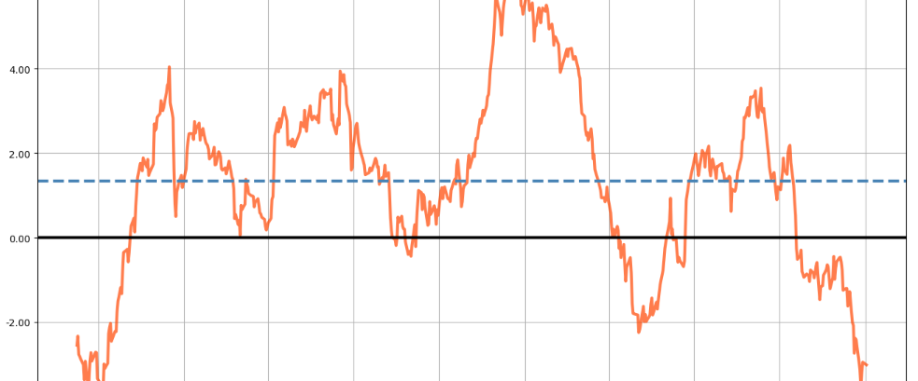
MHI Portfolios

Slide 2
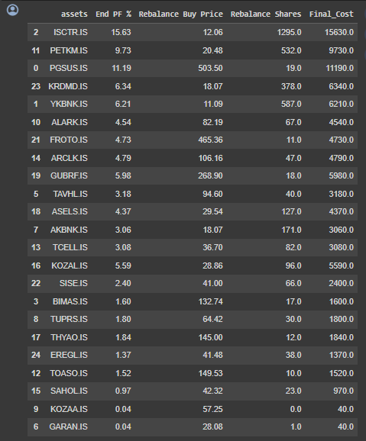
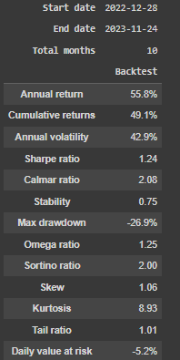
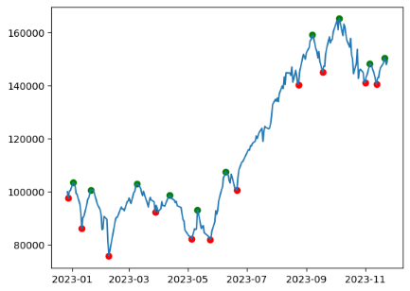
An optimized portfolio for 28.12.2022 – 24.12.2023

Slide 3
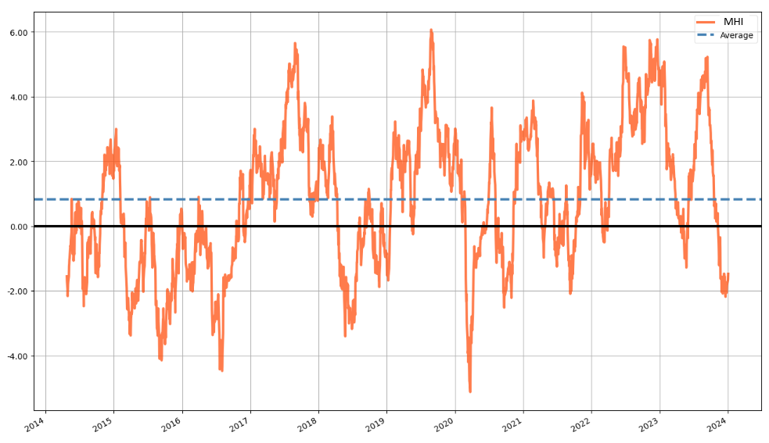
Market Health Index (MHI) - A mean-reverting index for trend detection

Slide 4
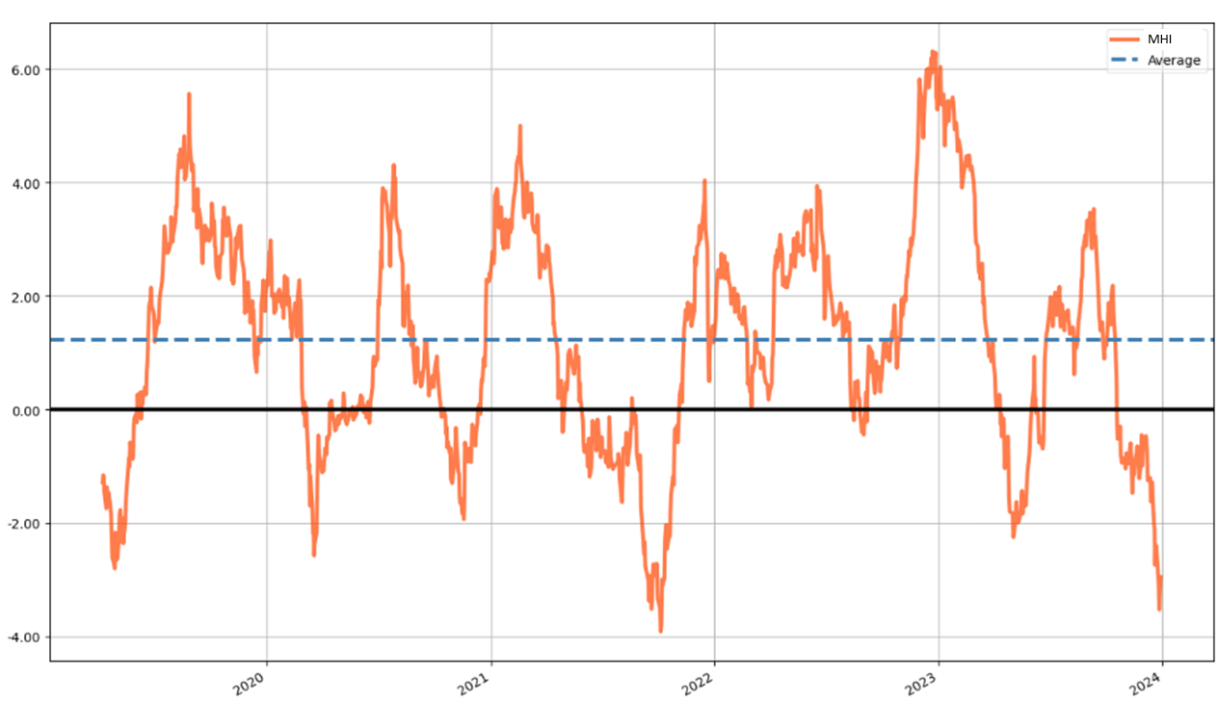
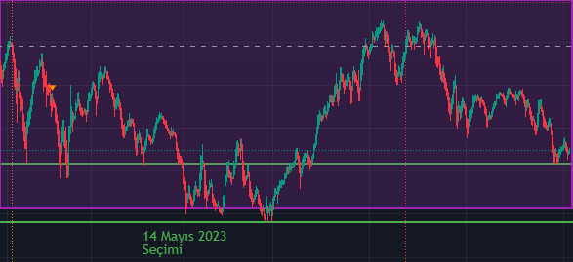
Market Health Index (MHI) - A mean-reverting index for trend detection
MHI on BIST30
Downtrend Uptrend
PREV UPTREND
23.08.2021 – 21.09.2022 21.09.2021 – 16.12.2021 (I)
16.12.2021 – 24.02.2022 24.02.2022 – 07.06.2022 (II)
07.06.2022 – 16.08.2022 16.08.2022 – 27.12.2022 (III)
27.12.2022 – 09.05.2023 09.05.2023 – 11.09.2023 (IV)
11.09.2023 – 26.11.2023 NEXT UPTREND
BIST100 – last 1 year
Last 5 years >>

Slide 5
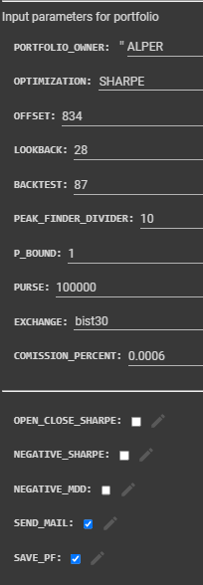
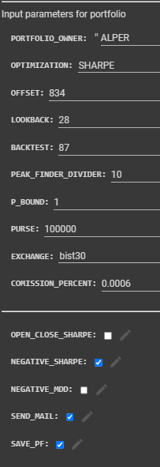
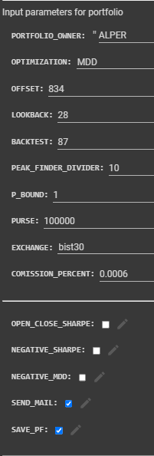
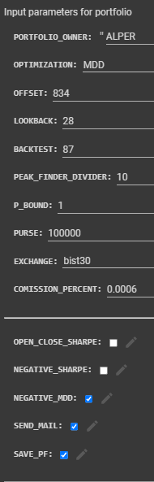
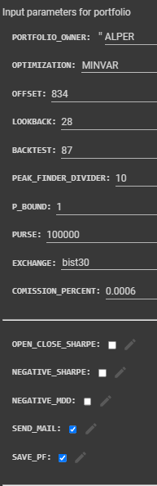
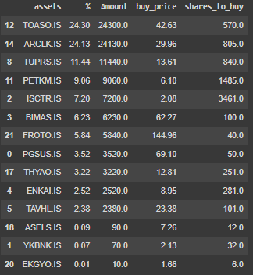

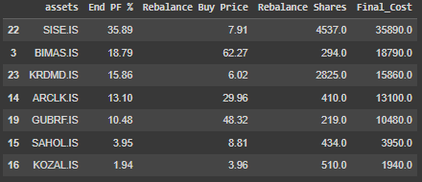

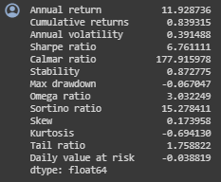
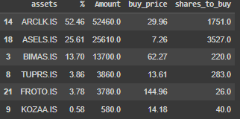
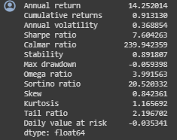
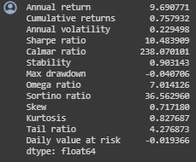
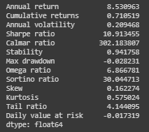
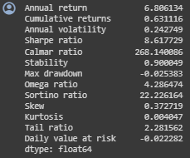
MHI portfolios for 21.09.2021 – 16.12.2021 (I)
Sharpe i-Sharpe MDD i-MDD MINVAR
Return: %91.3
SR: 7.6
MDD: %5.93
Return: %83.9
SR: 6.76
MDD: %6.7
Return: %75.8
SR: 10.48
MDD: %4
Return: %63.1
SR: 8.61
MDD: %2.53
Return: %71.1
SR: 10.91
MDD: %2.82

Slide 6
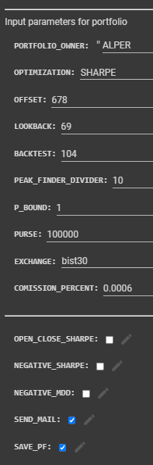
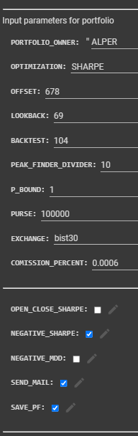
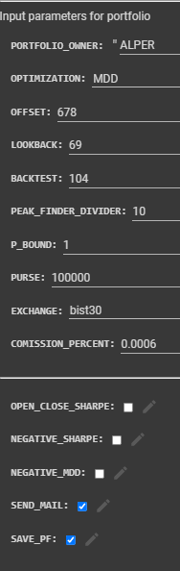
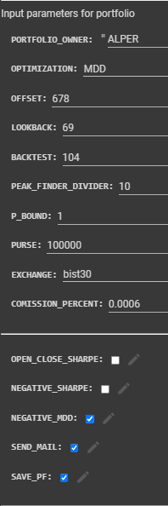
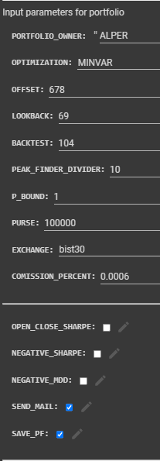

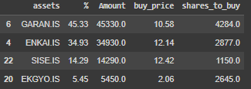


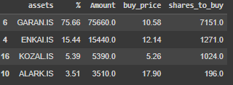
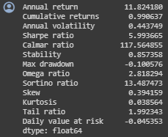
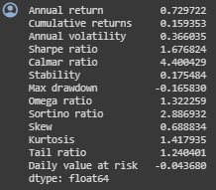
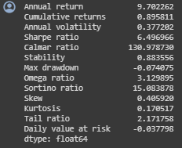
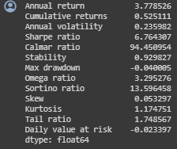
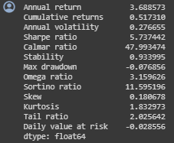
MHI portfolios for 24.02.2022 – 07.06.2022 (II)
Sharpe i-Sharpe MDD i-MDD MINVAR
Return: %99
SR: 5.99
MDD: %10.0
Return: %15.93
SR: 1.67
MDD: %16.58
Return: %89.6
SR: 6.49
MDD: %7.40
Return: %52.5
SR: 6.76
MDD: %4.0
Return: %51.7
SR: 5.73
MDD: %7.68

Slide 7
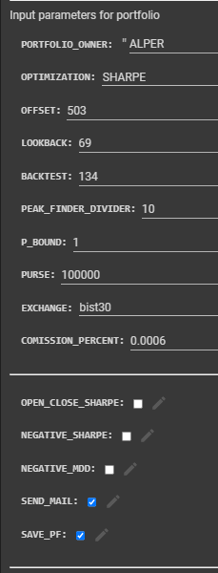
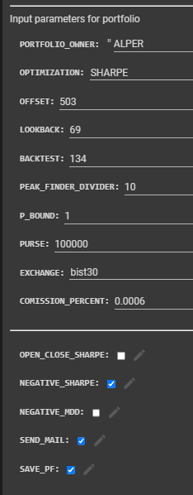
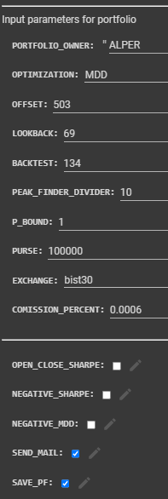
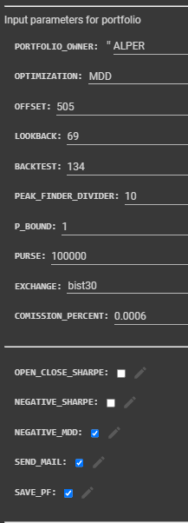
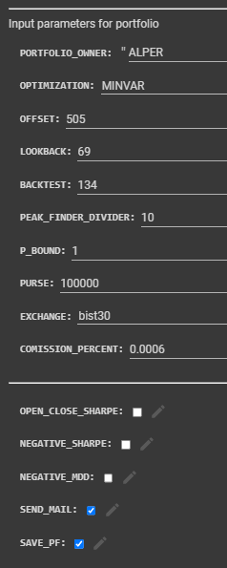
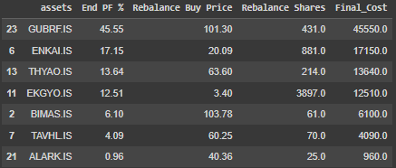
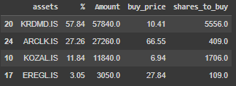
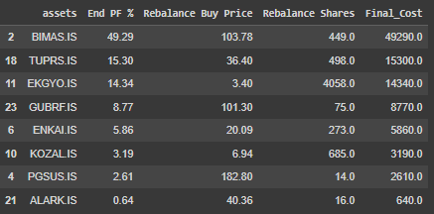

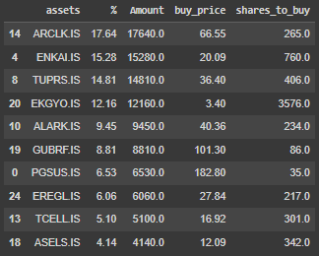
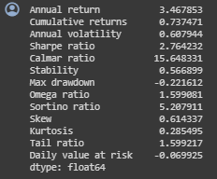
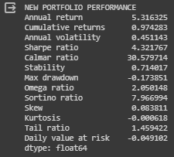
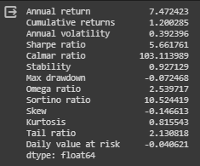
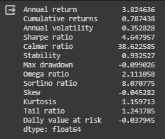
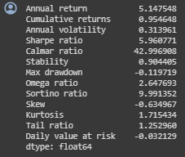
MHI portfolios for 16.08.2022 – 27.12.2022 (III)
Sharpe i-Sharpe MDD i-MDD MINVAR
Return: %73.7
SR: 2.76
MDD: %22.2
Return: %120
SR: 5.66
MDD: %7.2
Return: %97.4
SR: 4.32
MDD: %17.4
Return: %78.7
SR: 4.64
MDD: %9.9
Return: %95.5
SR: 5.96
MDD: %12.0

Slide 8
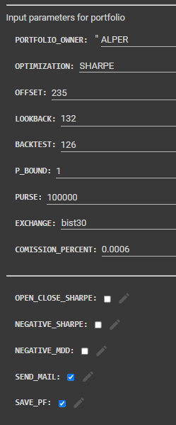
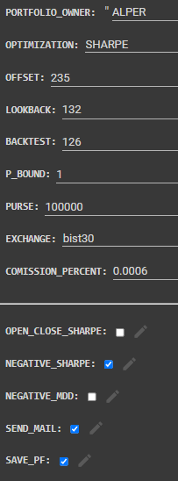
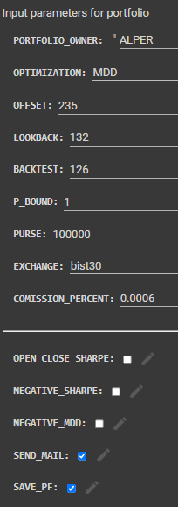
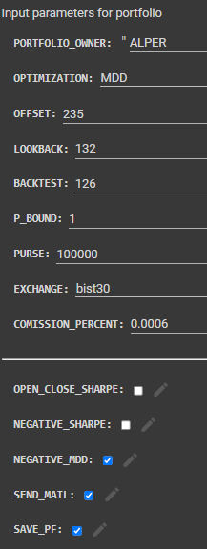











MHI portfolios for 09.05.2023 – 11.09.2023 (IV)
Sharpe i-Sharpe MDD i-MDD MINVAR
Return: %56.6
SR: 2.75
MDD: %13.7
Return: %65.6
SR: 3.39
MDD: %11.4
Return: %80.4
SR: 3.96
MDD: %16.1
Return: %64.3
SR: 3.96
MDD: %17.8
Return: %92.3
SR: 4.82
MDD: %12.4

Slide 9


PORTFÖY | BAŞLANGIÇ | BİTİŞ | KAR
MHI SHARPE-ALTIN KONSOLİDE | 27.12.2022 | 26.12.2023 | 115,45%
MHI SHARPE-ALTIN KONSOLİDE | 16.12.2021 | 26.12.2023 | 891,79%
MHI SHARPE-ALTIN KONSOLİDE | 21.09.2021 | 26.12.2023 | 1797,30%
MHI MDD-ALTIN KONSOLİDE | 27.12.2022 | 26.12.2023 | 164,57%
MHI MDD-ALTIN KONSOLİDE | 16.12.2021 | 26.12.2023 | 842,53%
MHI MDD-ALTIN KONSOLİDE | 21.09.2021 | 26.12.2023 | 1512,67%
GR ALTIN | 27.12.2022 | 26.12.2023 | 78,25%
GR ALTIN | 16.12.2021 | 26.12.2023 | 126,67%
GR ALTIN | 21.09.2021 | 26.12.2023 | 293,92%
USDTRY | 27.12.2022 | 26.12.2023 | 57,15%
USDTRY | 16.12.2021 | 26.12.2023 | 97,90%
USDTRY | 21.09.2021 | 26.12.2023 | 240,00%

Slide 10
Procedure for Portfolio Construction
Calculate and plot 5 year-MHI
Detect peaks (MHI > 4) and valleys (MHI < -2)
Apply Correlation filter
At the valleys, starting from latest peak calculate portfolio and enter that portfolio.
At the first peak, sell the portfolio.

Slide 11

Filter for Correlation

Slide 12

Filter for Correlation

Slide 13


Filter for Volatility

Slide 14

Robofon portföyleri (downtrend dönemi)

Slide 15

Robohisse portföyleri (downtrend dönemi)

Slide 16


Hisse / Fon uzayı seçimi

Slide 17
Robofon portföyleri (uptrend dönemi)
MINVAR
SHARPE
MDD

Slide 18
Robohisse portföyleri (uptrend dönemi)
MINVAR
SHARPE
MDD

Slide 19









Robofon portföyleri (downtrend dönemi)
MINVAR
SHARPE
MDD

Slide 20












Robohisse portföyleri (downtrend dönemi)
MINVAR
SHARPE
MDD

Slide 21

Our product
AI assisted portfolio generation in Python with
Entry exit based on MHI – mean reverting Market Health Index
Sharpe, i-sharpe, MDD, i-MDD, MINVAR optimized
Correlation volatility, fundamentals and KAP news filtering
Consolidated returns

Slide 22
We should target for the new frontier
Hidden Markov Models
Mean reverting strategies

